Slide 1







Slide 2






































•
•
•

Slide 3













































•
•

Slide 4



































•
•
•

Slide 5























Slide 6


















•
•

Slide 7








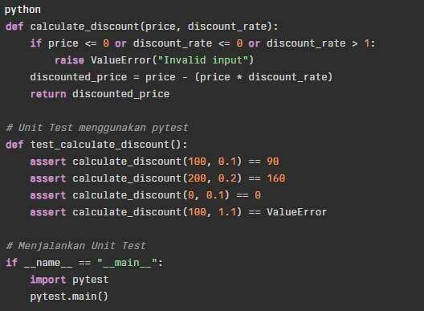




Slide 8













Slide 9





























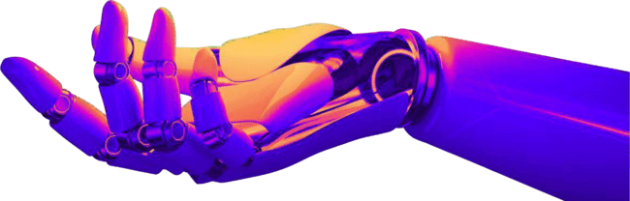

Slide 10























Slide 11

































•
•
•
•

Slide 12


















Slide 13

















Slide 14





























•
•
•
•

Slide 15


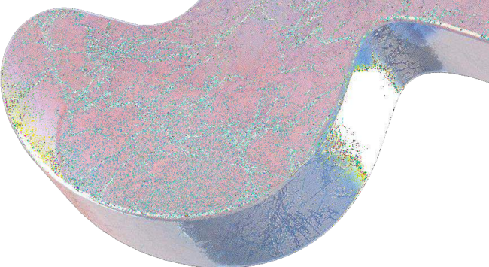

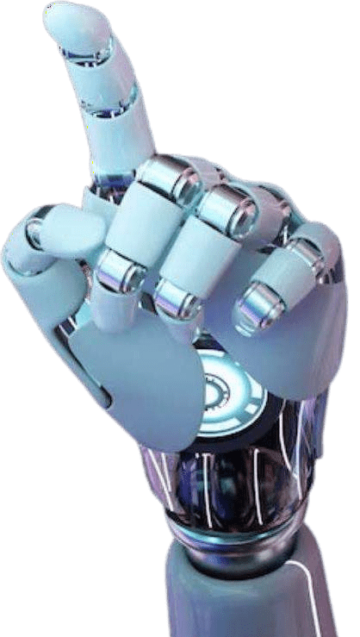







Slide 16








































•
•
•
•
•

Slide 17







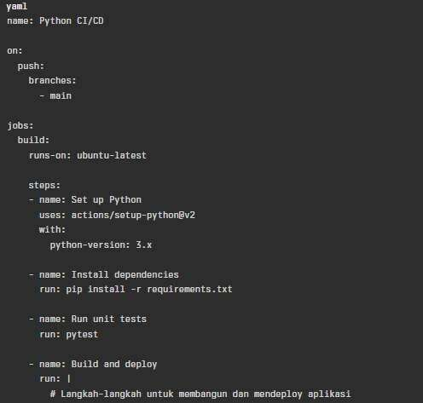




Slide 18



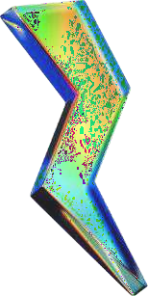


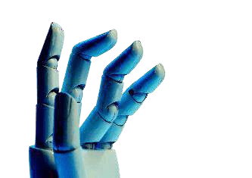


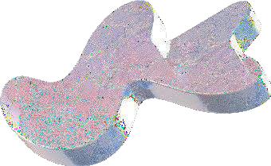
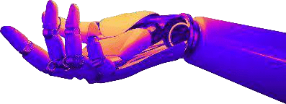
Real Python. (2023). Continuous Integration With Python: An Introduction. Diakses pada 4 November 2023, dari https://realpython.com/python-continuous- integration/
Semaphore CI. (2022). Python Continuous Integration and Deployment From Scratch. Diakses pada 4 November 2023, dari https://semaphoreci.com/blog/python-continuous- integration-continuous-delivery
Inedo Blog. (2022). Integrating CI/CD into Your Python Development. Diakses pada 4 November 2023, dari https://blog.inedo.com/python/development-and-cicd/
The Hitchhiker's Guide to Python. (2023). Continuous Integration. Diakses pada 4 November 2023, dari https://docs.python-guide.org/scenarios/ci/
Towards Data Science. (2021). CI/CD by Example in Python. Diakses pada 4 November 2023, dari https://towardsdatascience.com/ci-cd-by-example-in- python-46f1533cb09d
asap developers. (2021). Python for CI/CD. Diakses pada 4 November 2023, dari https://www.asapdevelopers.com/python-for-ci-cd/

Slide 19
https://www.asapdevelopers.com/ python-for-ci-cd/
https://towardsdatascience.com/ci
-cd-by-example-in-python- 46f1533cb09d
https://blog.inedo.com/python/dev elopment-and-cicd/
https://semaphoreci.com/blog/pyt hon-continuous-integration- continuous-delivery
https://realpython.com/python- continuous-integration/

Slide 20




